Slide 1

Pizza Sales Analytics Report
Transforming raw data into actionable business insights for optimized performance.

Slide 2

Project Overview & Data Source
Project Aim
Analyze pizza sales data using SQL and visualize insights with Power BI to understand sales trends and customer preferences.
Dataset: 534,820 rows, 13 columns.
Data Source
CSV file containing order-level pizza sales data (date, type, category, size, quantity, price).
Imported into SQL database for analysis.

Slide 3
SQL Data Processing & Analysis
SQL was the primary tool for data analysis, calculating KPIs and answering key business questions.
1
2
Basic Analysis
Time-Based Trends
Total revenue, orders, quantity sold, average order value, pizzas per order.
Daily and monthly sales performance, peak days/months, weekday vs. weekend sales.
3
4
Category & Size
Product Performance
Revenue contribution by category/size, most frequent sizes, AOV by size.
Top/least selling pizzas, high revenue/low volume products, menu optimization.

Slide 4
Advanced SQL & KPI-Oriented Questions
Leveraging SQL for deeper insights and Power BI integration.
Advanced Analysis
SQL → Power BI Integration
Rank pizzas by category revenue.
Identify peak sales periods.
Calculate cumulative revenue.
Identify seasonal demand patterns.
KPIs visualized in dashboard.
SQL-derived KPIs improve performance.
SQL data transformation reduces Power BI load.
SQL aggregation improves reporting accuracy.

Slide 5

Business-Oriented Questions Answered by SQL
SQL analysis provides actionable insights for strategic decision-making.
Promote Pizzas
Discontinue Products
Identify pizzas for promotion to increase revenue.
Determine underperforming products for discontinuation.
Optimize Staffing
Improve Inventory
Use peak-day sales analysis for efficient staffing.
Enhance inventory planning based on sales trends.

Slide 6
Key Performance Indicators (KPIs)
Critical metrics calculated using aggregate SQL functions.
5
5
5
5
Total Revenue
Total Orders
Avg. Order Value
Total Quantity Sold
Overall sales performance.
Volume of customer transactions.
Average spend per order.
Overall pizza units moved.
2
Sales Contribution
By category and size.

Slide 7

Power BI Integration & Transformation
Connecting Data
Analyzed SQL data connected to Power BI for visualization.
Power Query Transformations
Converted pizza size abbreviations.
Created new date-related columns (Day Name, Month Name).
Applied conditional formatting.
Validated and cleaned data types.

Slide 8


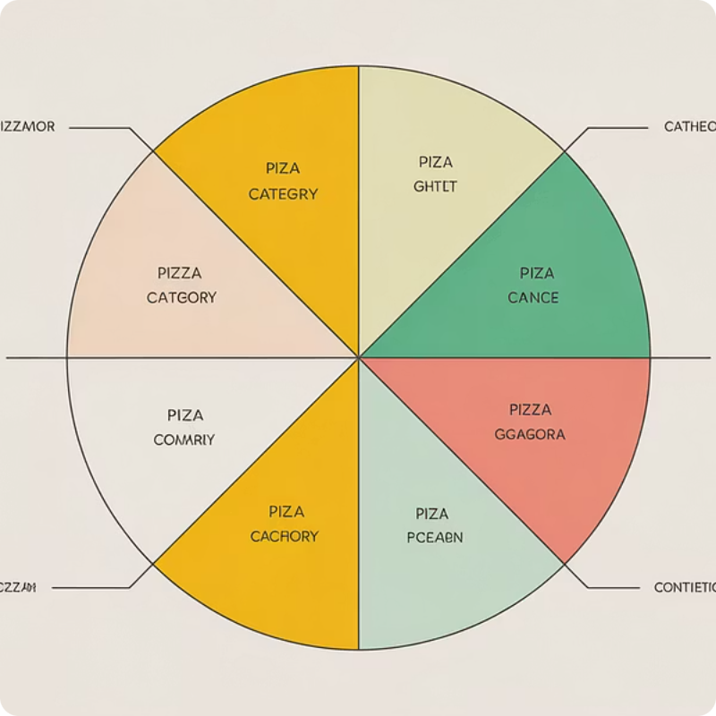
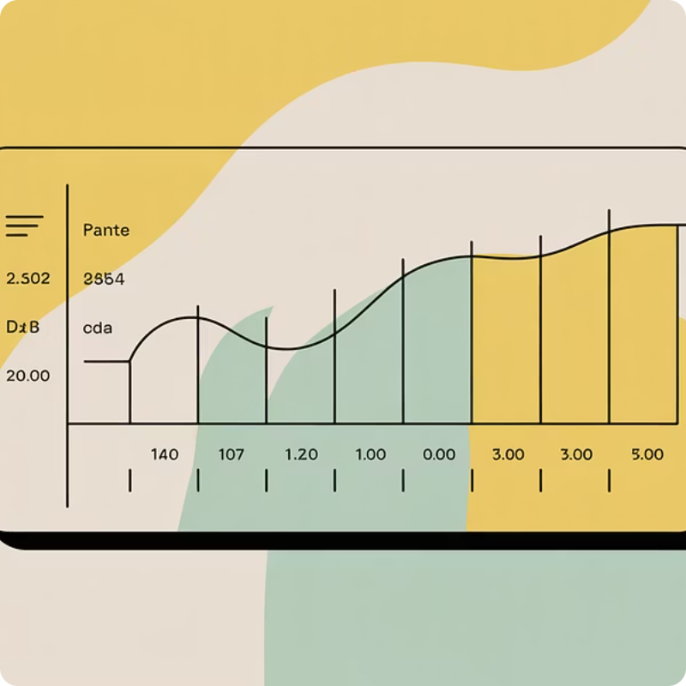
Interactive Dashboard Development
An interactive Power BI dashboard provides dynamic exploration of sales trends.
KPI Cards
Bar Charts
Line Charts
Slicers
Quick overview of key performance indicators.
Visualizing sales distribution and comparisons.
Tracking trends and changes over time.
Allowing users to dynamically filter and explore data.

Slide 9

Key Business Insights
Analysis reveals critical information for optimizing business strategies.
Peak Sales
Optimization Strategies
Top Performers
Underperforming Products
These insights help optimize inventory, staffing, pricing, and marketing campaigns.

Slide 10

Conclusion: Data-Driven Decisions
This project effectively integrates SQL analysis with Power BI visualization.
Empowering Businesses
Supports data-driven decision-making for improved business performance.
Future Growth
A robust solution for continuous sales analytics and strategic planning.

